Slide 1
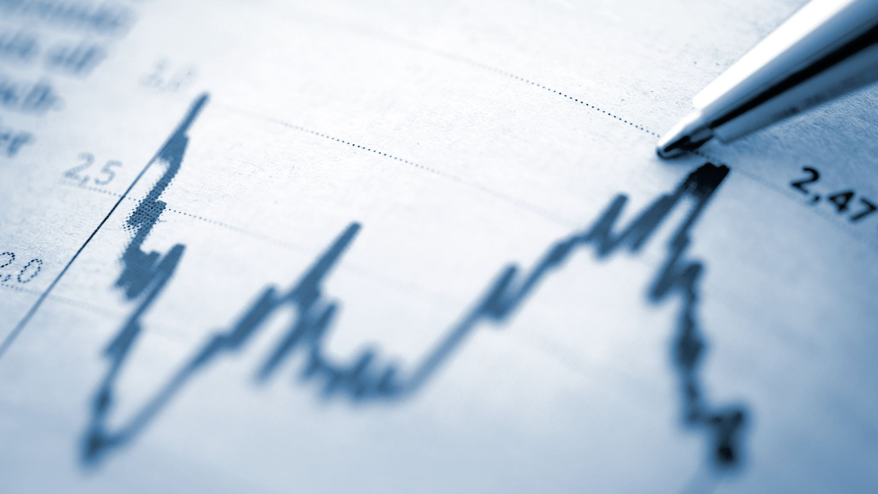
Neural Networks and Sales Models with Economic Indicators: A study of sales trends over the last couple decades including the Covid-19 Era
Kevin Xue, Nick O'Brien, Kaiyuan Zhao, Yuetong Zhang, Kehan Yu, Lingyan He, Haiyan Huang

Slide 2
Let's set the scene
Millions of companies are thriving and growing in the process of economic globalization and become even more profitable with the advent of new and improved sales models brought on by new technology. This technology allows companies to take stock of their inventory and predict future sales during the different seasons depending on their type of sale. Clothing stores predict the number of shoes sold and what shoes are sold, sports shops predict the number of clubs sold on that particular week during the baseball season, and a mechanic wipes his brow after a particularly busy day perfectly predicted by his model, allowing him to call in the right number of apprentices for the day shift. Things are going fantastic for the economy globally, entrepreneurs are reaping the rewards of their investments, and governments are able to raise even more money through the newfound efficiency of the economy and sales ecosystems. In all, undoubtedly, the financial outlook of businesses looks promising, and the consumer experience grows by the day.

Slide 3
That is, until...

Slide 4
The result
Stores begin closing, shoppers are suddenly in a toilet paper buying frenzy, your neighbor Joe is wearing the plague doctor mask from his son's Halloween costume, and others even begin contemplating building a bunker to wait the ensuing pandemic out. It seems like the world has gone mad. Despite the apparent hilarity and surrealness of the situation, bigger problems have arisen in the economy. Not only is the local Starbucks laying off half its workers, or the local gym owner listing the facility for sale, but the sales models at the stores... have stopped working. Almost entirely. In fact, almost all of the grocery stores have stopped functioning efficiently. The immediate and ensuing downturn in the sales rates has left even the most accomplished economists and sales employees in shock, and accountants stare at their ledgers petrified in fear. All of the major industries face economic peril, with deficits in the millions per day

Slide 5
The proposition
In order to address this issue, we're going to take a unique approach on the creation of new sales models. Instead of relying on previous sales data, which have almost entirely gone to inaccuracy in the middle of the pandemic, we can both rely on sales data and economic indicators throughout the previous time period as well as through the post-outbreak world we live in today.
we hypothesize that by running a neural network on economic trends in the United States, such as unemployment, inflation, and a myriad of other factors, we can identify economic indicators with a strong correlation to sales, and therefore to the general industries, creating an efficient sales model that takes in nationwide data.
The hope is that with this data, industrial companies and stores will be able to create robust models based on our conclusions, and apply them to their own sales situations now and into the future, when a similar economic crisis may occur

Slide 6
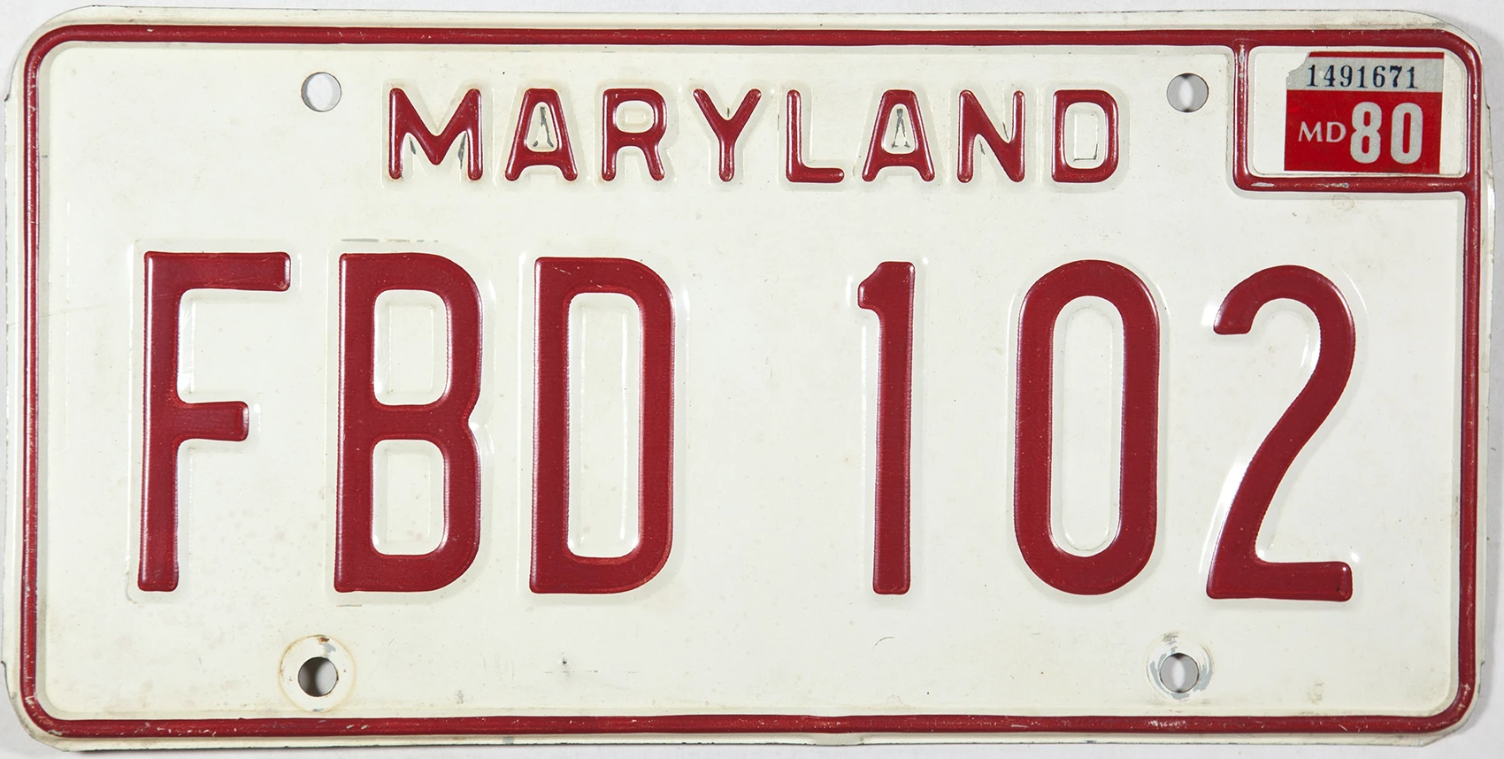
The datasets/baseline dataframing
Costco Retail Sales 2012-2021
- A dataset of Costco sales since 2012 in monthly intervals
- Dependent column kept as total sales, other columns dropped
- Added years as a numerical value, repeated values in between 1 and 12 to represent months
*Note: Dataframes cannot include strings for the program to run*
Maryland Vehicle Sales 2002-2021
- A dataset of Maryland vehicle sales since 2002 in monthly intervals
- Total Sales calculated by combining new and used purchases, other columns dropped
- Added years as a numerical value, repeated values in between 1 and 12 to represent months

Slide 7
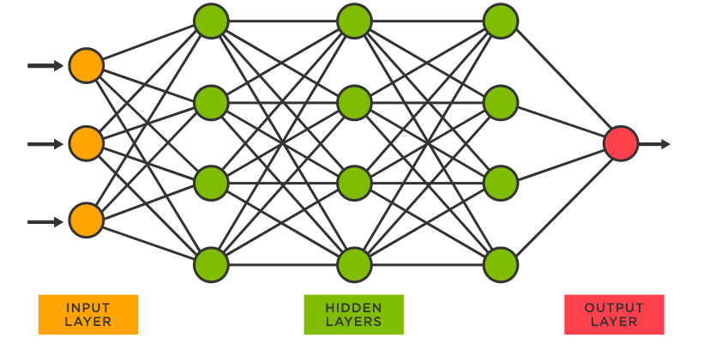
The Neural Network: A Brief Overview of the Workings
To test this hypothesis, we will implement neural networks. An artificial neural network, as defined, is a computing system designed to simulate the way the human brain analyzes and processes information. It is the foundation of artificial intelligence (AI) and solves problems that would prove impossible or difficult by human or statistical standards, yielding better results than regression methods. Neural networks are comprised of layers in which perceptrons, or neurons, are located and connected to each other. These edges between neurons are assigned weights, which change as the network runs and backpropagates, assessing the error of the model, and training itself further through adjusting the weights of the edges, leading to less and less of an error. Through constant revision and manipulation of both the regressors and the other features of the network, we are able to develop a robust feedforward neural network that effectively models the sales data for a particular year.

Slide 8
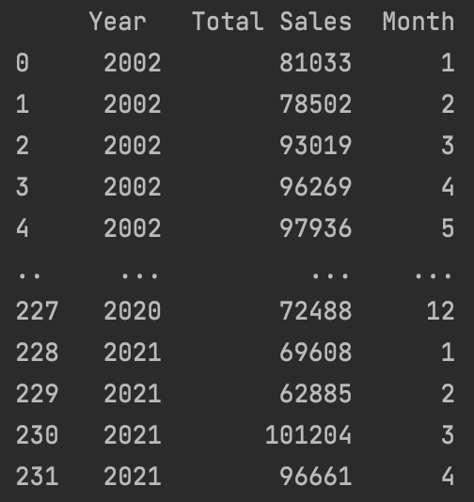
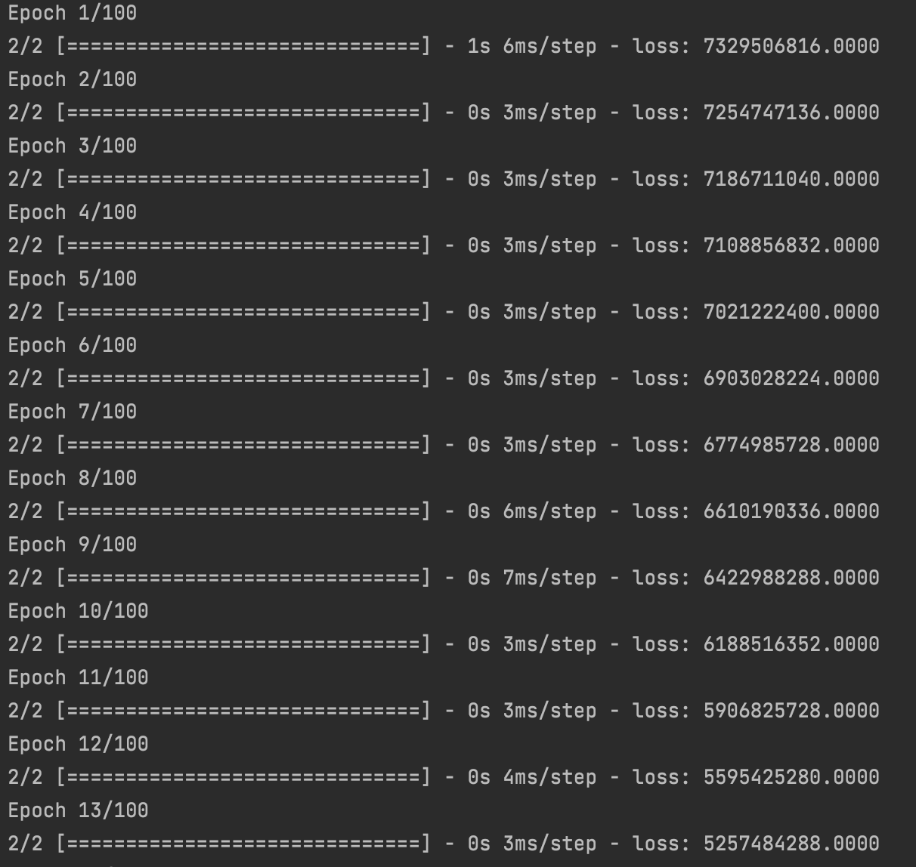
Training the Neural Networks

Slide 9
The initial result without economic indicators
For both datasets, we initially tested them to determine the discrepancy between 2020 sales data and sales data for years before 2020​
We wanted to determine whether there is a difference between how sales were affected in different industries, particularly vehicle sales and food/grocery sales​
This was an initial result, and we intended this to serve as a control to determine the effectivity of the other economic indicators which we planned to implement​
The results are as follows:

Slide 10
The initial result without economic indicators
 | Costco Sales 2012-2021 (billions) | Maryland Car Sales 2002-2021
Sample Year | N/A | 2018
Sqrt Loss Value (averaged over 30) | 2.38335 | 12081
Standard Deviation | 2.70573 | 12077
Percentage Loss Value | 0.8808 | 1.000331208
2020 Sqrt Loss Value (averaged over 30) | 5.704559876 | 11951
2020 Standard Deviation | 2.705736549 | 11626
2020 Percentage Loss Value | 2.108320516 | 1.027954585

Slide 11
Adding Economic Indicators
In light of the ratios between square root loss and the standard deviation for both datasets in years before 2020 and specifically 2020, we decided to add economic indicators to the dataframes as additional regressors to improve accuracy
These regressors include Balance of Trade, Exports, Employment Rates, Inflation Rate, Consumer Price Index, and Income Tax for the United States
It turns out that some indicators did not seem to work as regressors for the datasets, doubling the square root loss, and others did, reducing the square root loss by a significant amount

Slide 12
The final result with economic indicators: What didn't work
Balance of Trade
- Produced a result which dramatically decreased the accuracy of the model. The square root loss doubled
- We hypothesize that the balance of trade would not affect sales much - The balance of trade was not necessarily changed much during Covid. There was not enough data to determine how the balance of trade should have changed, and the government may not have adjusted their balance of trade correctly
- Thus, governments changing their balance of trade did not change along with sales

Slide 13
The final result with economic indicators: What didn't work
Exports
- Produced a result which dramatically decreased the accuracy of the model. The square root loss also doubled
- We hypothesize that the exports would not affect sales much - exports did not necessarily change internal sales at the same rate as sales during Covid. Exports may have dropped dramatically
- Thus, governments changing their exports or dropping them completely does not change along with sales and internal factors

Slide 14
The final result with economic indicators: What didn't work
Income Tax
- Income tax did not change much during the Covid period, and therefore, income tax did not have a significant impact on sales
- Thus, income tax should not have changed the square root loss value by much and through experimentation, it changed the square root loss value by only approximately 0.05 for the Costco dataset

Slide 15
The final result with economic indicators: What worked - Maryland Car Sales (control)
Inflation Rate
- Using inflation data of the United States from the time period of 2002 to 2021, we ran the network and found significant improvement
- Over 30 trials for both the sales values with inflation as a regressor and without, we were able to identify an approximate 4% reduction in square root loss during the Covid period
Inflation Rate | With Factor | Without Factor | Change
Year 2020 | 11468.57 | 11951.17 | 0.96

Slide 16
The final result with economic indicators: What worked - Maryland Car Sales
Employment Rate
- Using employment data of the United States from the time period of 2002 to 2021, we ran the network and found significant improvement
- Over 30 trials for both the sales values with employment rate as a regressor and without, we were able to identify an approximate 5.5% reduction in square root loss during the Covid period
100 – Employment Rate | With Factor | Without Factor | Change
Year 2020 | 11294.6 | 11951.17 | 0.945

Slide 17
The final result with economic indicators: What worked - Maryland Car Sales
CPI
We predict that CPI will already work with this model since it stays relatively consistent during the Covid period and that CPI is a direct indicator of sales. Thus, we will explore this in the Costco set, where CPI will be more important

Slide 18
The final result with economic indicators: What didn't work - Costco
No employment percentage
- Using the no employment rate of the United States in the past 9 years from 2012- 2021, we were able to identify the square root loss value with no employment percentage as a regressor.
- We found a reduction of only 1% as well. This is likely not statistically significant, and thus, the data should not be used as a regressor - Note this economic indicator worked for vehicle sales
No employment | With Factor | Without Factor | Change
Before 2020 | 2.0866 | 2.3833 | 0.8754
2020 | 5.6428 | 5.7045 | 0.9891

Slide 19
The final result with economic indicators: What worked - Costco
Inflation rate
- Using the inflation rate of the United States in the past 9 years from 2012- 2021, we were able to identify the square root loss value with inflation rate as a regressor.
- We found a reduction change of only 1%. This seemed insignificant, however, in combination With CPI, it became significant
Inflation Rate | With Factor | Without Factor | Change
Before 2020 | 1.9588 | 2.3833 | 0.8218
2020 | 5.6462 | 5.7045 | 0.9897

Slide 20
The final result with economic indicators: What worked - Costco
CPI
- Using the CPI of the United States in the past 9 years from 2012- 2021, we were able to identify the square root loss value with CPI as a regressor - We found a percentage change of about 13.5%. This is significant, and thus, the data should be used as a regressor
- Note that CPI has a direct correlation to sales, so it will cause a larger reduction in loss
Inflation Rate | With Factor | Without Factor | Change
Before 2020 | 2.1271 | 2.3833 | 0.8925
2020 | 4.9342 | 5.7045 | 0.8649

Slide 21
The final result with economic indicators: What worked - Costco
CPI and Inflation Rate
- Using the CPI of the United States in the past 9 years from 2012- 2021, we were able to identify the square root loss value with CPI and inflation rate as a regressor
- We found a percentage change of about 25%. This is significant, and thus, the data should be used as a regressor
- Unexpectedly, the combination of CPI and inflation Rate yielded much better results
Inflation Rate | With Factor | Without Factor | Change
Before 2020 | 1.4771 | 2.3833 | 0.6297
2020 | 4.2851 | 5.7045 | 0.7511

Slide 22
Ranking the Factors
Based on the results and the changes in the loss we encountered, the economic indicators we tested are ranked in the following order:
1. CPI
2. Inflation Rate
3. No employment percentage
4. Exports
5. Balance of Trade
6. Income Tax

Slide 23
Conclusions
Although we only tested several economic indicators due to the constraint of time, we can conclude the following
- The economic indicators of CPI and Inflation Rate when combined are extremely effective at determining the sales of an industry affected by Covid during 2020
- Covid-unaffected industries, such as the automobile industry, are less affected by Covid and are easier to predict with common nationwide economic indicators
- More research must be done to generate the most optimal model through the testing of more economic indicators and possibly other indicators, which we will continue in the upcoming months

Slide 24
A special thanks to the following
Professor Iosevich, for sticking with us through the highs and the lows, even when there was not a clear solution in sight
Yiyang Su, for helping us clear up technical difficulties with Tensorflow
The National Science Foundation, for providing the funds necessary to keep this program running
The University of Rochester and Cornell University, for heading the initiative to run this program

Slide 25
NSF Grant Info
Tripods NSF Grant info: US NSF HDR TRIPODS 1934962

